Slide 1

Airlines Reservation System
Harish Singh Bisht
00221102010
Geetanjali
01121102010

Slide 2
Features of our project
User friendly
Easy to operate
database system for all sizes of airlines
Make the reservation and ticketing easier
Reducing the time
Reducing the paper work
Easy to searching the information about flights
Easy Cancellation

Slide 3
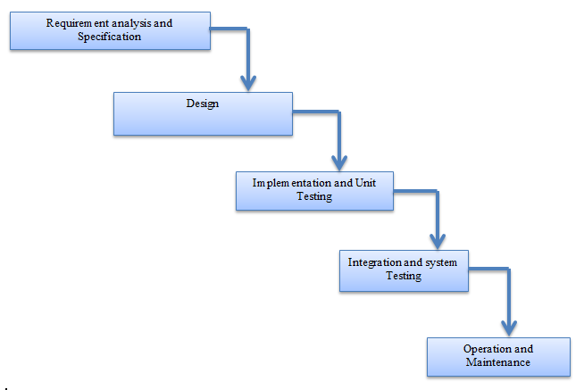
Proposed Methodology or Technique of Project Design(Waterfall Model)

Slide 4
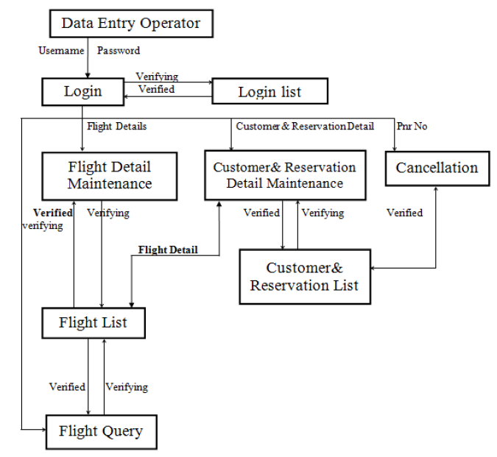
Block diagram

Slide 5
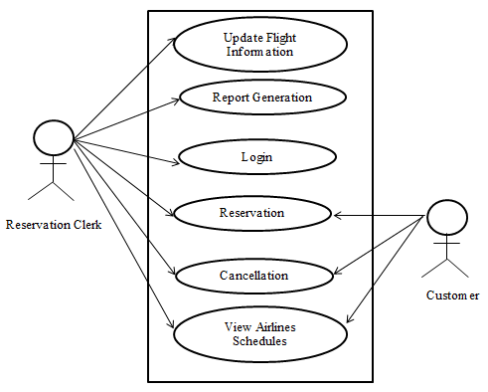
USE CASE DIAGRAM

Slide 6
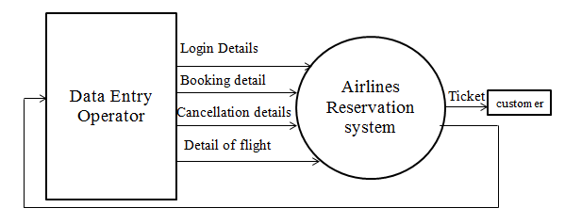
Zero level DFD of Ticket Booking

Slide 7
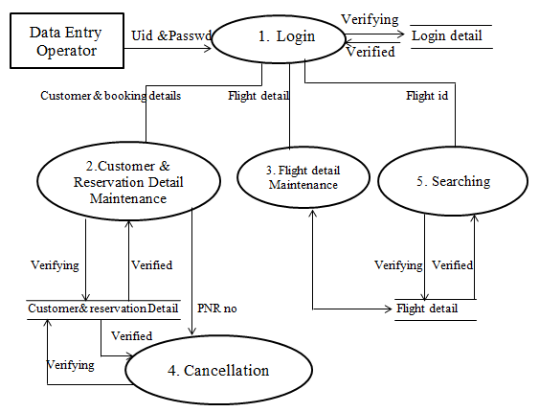
First level DFD of ticket booking

Slide 8
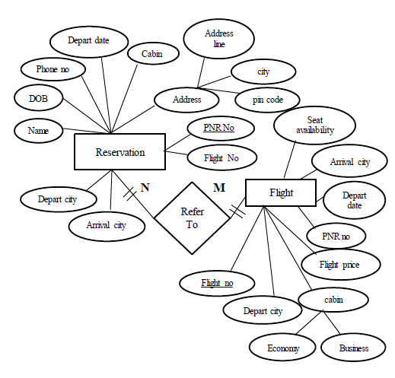
ER DIAGRAM

Slide 9
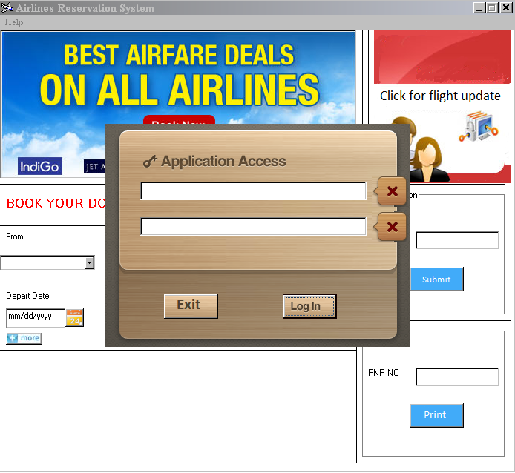
Input Screens
Validation:- If we won’t give the user name & password then we won’t be login into the working system.

Slide 10
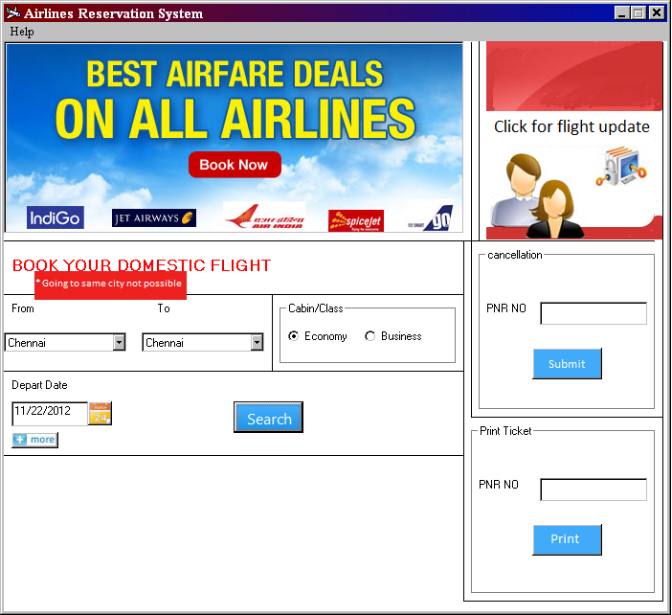
INPUT SCREEN
Validation:- we cannot input both departure & arrival city’s same.

Slide 11
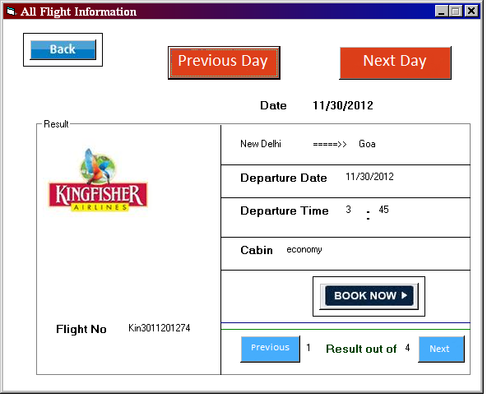
Output screen
This is the “all flight information” screen of the flight by which we can check all flight related to our journey and select the best one

Slide 12
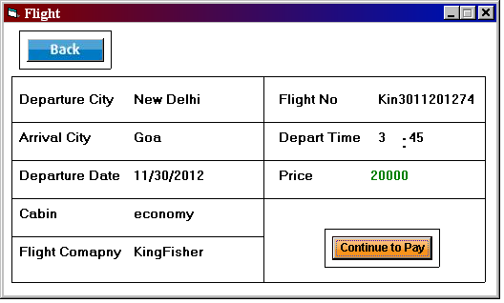
Output screen
This is the output screen for the processing of continuation of payment for booking the flight.

Slide 13
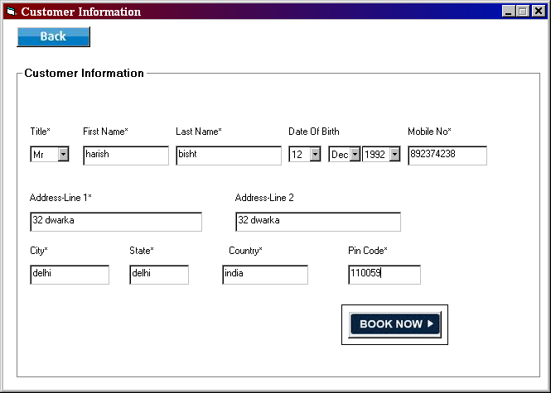
Input screen
Here we are inserting the customer data/information, which are very essential for booking the ticket, the title, first name, last name, mobile no, address-line 1, city, state, country & pin code cannot be left blank.

Slide 14
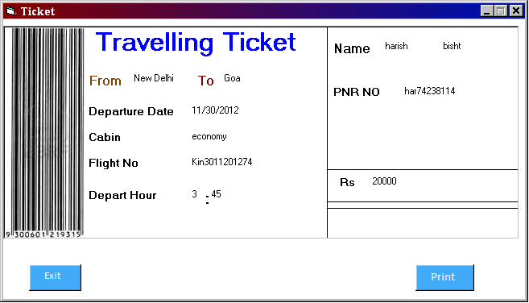
Output screen
This is the ticket, the main required output of our project. Where pnr no is given which shows that this ticket belongs to which particular person.

Slide 15
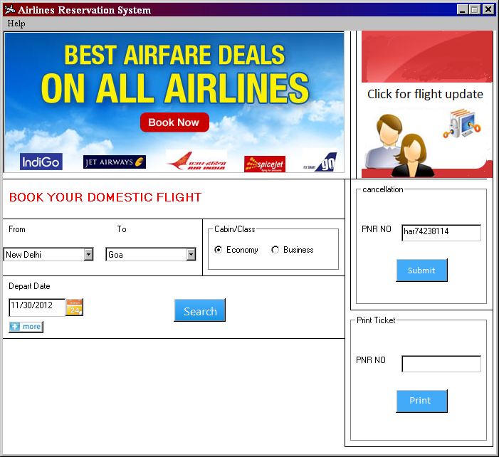
Input screen
Here if we want to cancel the ticket which we have booked we can cancel it by inserting the pnr no of the particular ticket.
Validation :- for the cancellation pnr no should be inserted, it cannot be left blank.

Slide 16
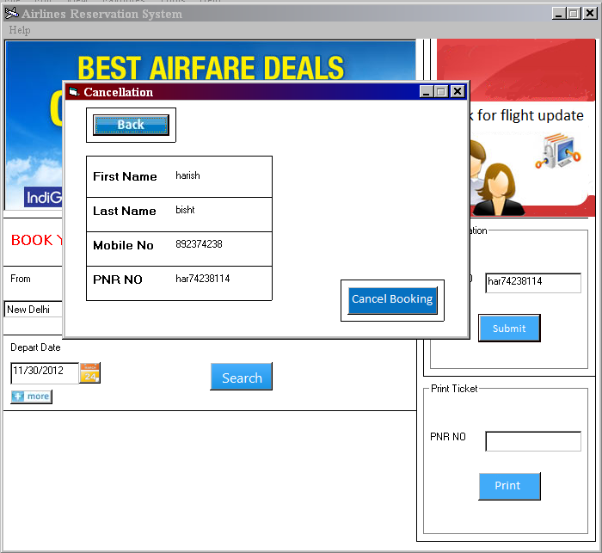
Output screen
Here it is the final step for the cancellation of ticket, if we want to cancel then “cancel booking” should be clicked or if not then “back” should be clicked.

Slide 17
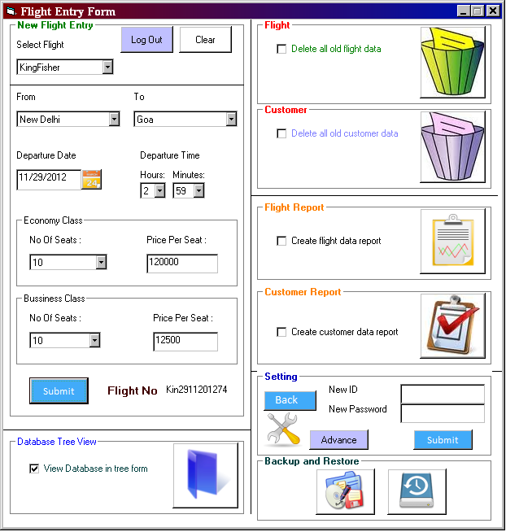
Input screen
Validation:- In settings New ID & New Password should not be blank. Without it we cannot insert the entry for flight booking.

Slide 18
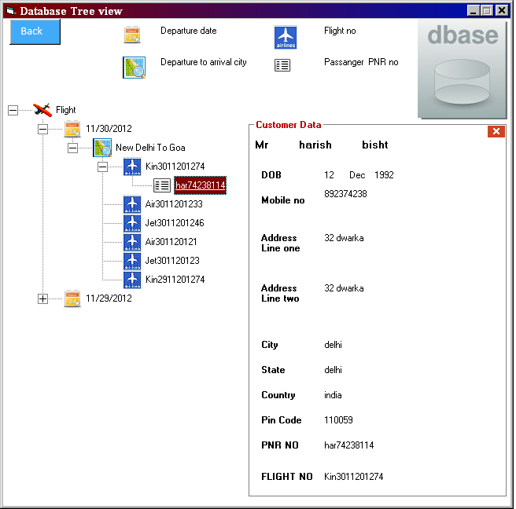
Database TREE view
Database tree view make easier search of customer detail and flight detail

